Slide 1
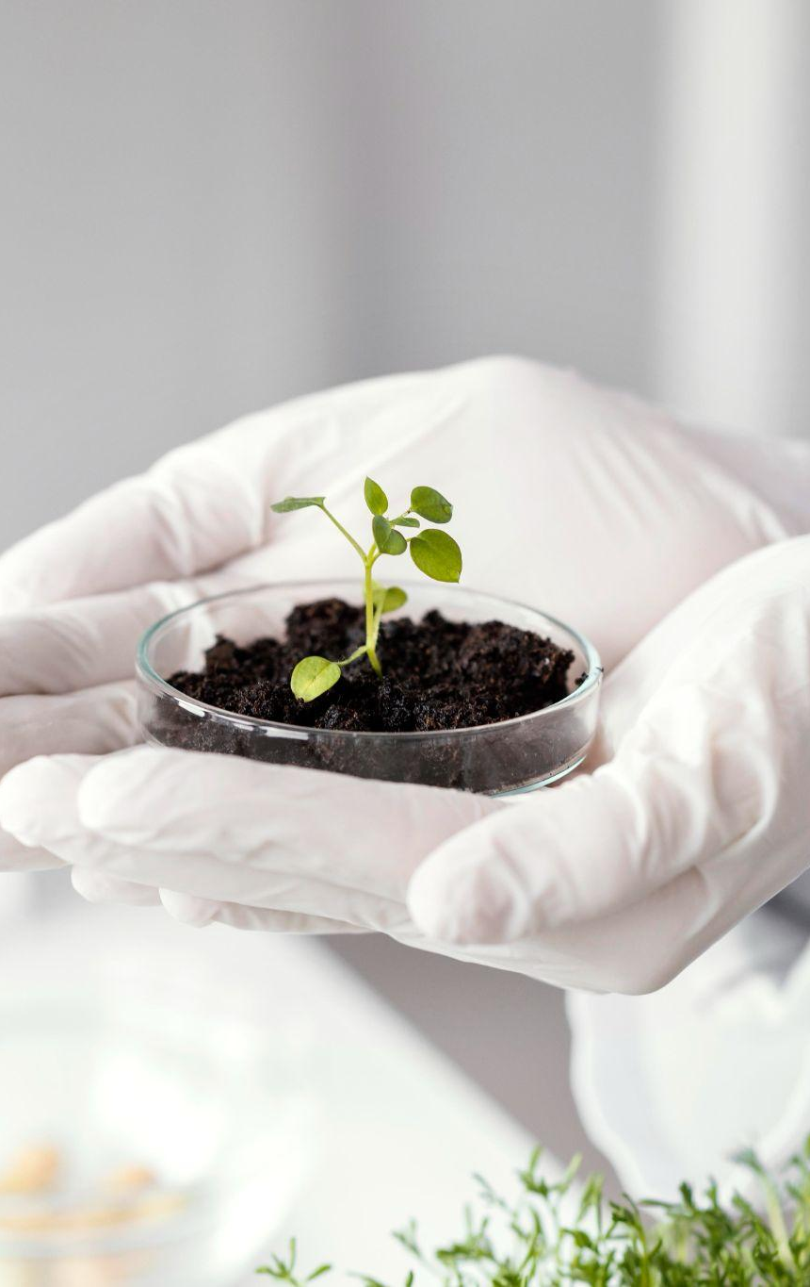
Web Based System For Precision Agriculture Applications In 5G-Based Internet Of Things
Faculty of Engineering​ at Aswan University
Electrical Engineering Department Computer Engineering, 2023
Supervisors: Dr. Montaser M. Ramadan
Dr. Hamada Ahmed Hamada
Dr. Adel Fathy Khalifa
Dr. Mostafa Mohamed Abbas
Eng. Hossam Badry

Slide 2
Overview
01
02
03
04
Introduction
Deep Learning
Problem definition, solution,
Related work and Real products
Datasets, Models and Challenges
Mobile Development
Embedded System
Android and Deployment

Slide 3
Overview
05
06
Front-end Development
Backend RESTful API

Slide 4
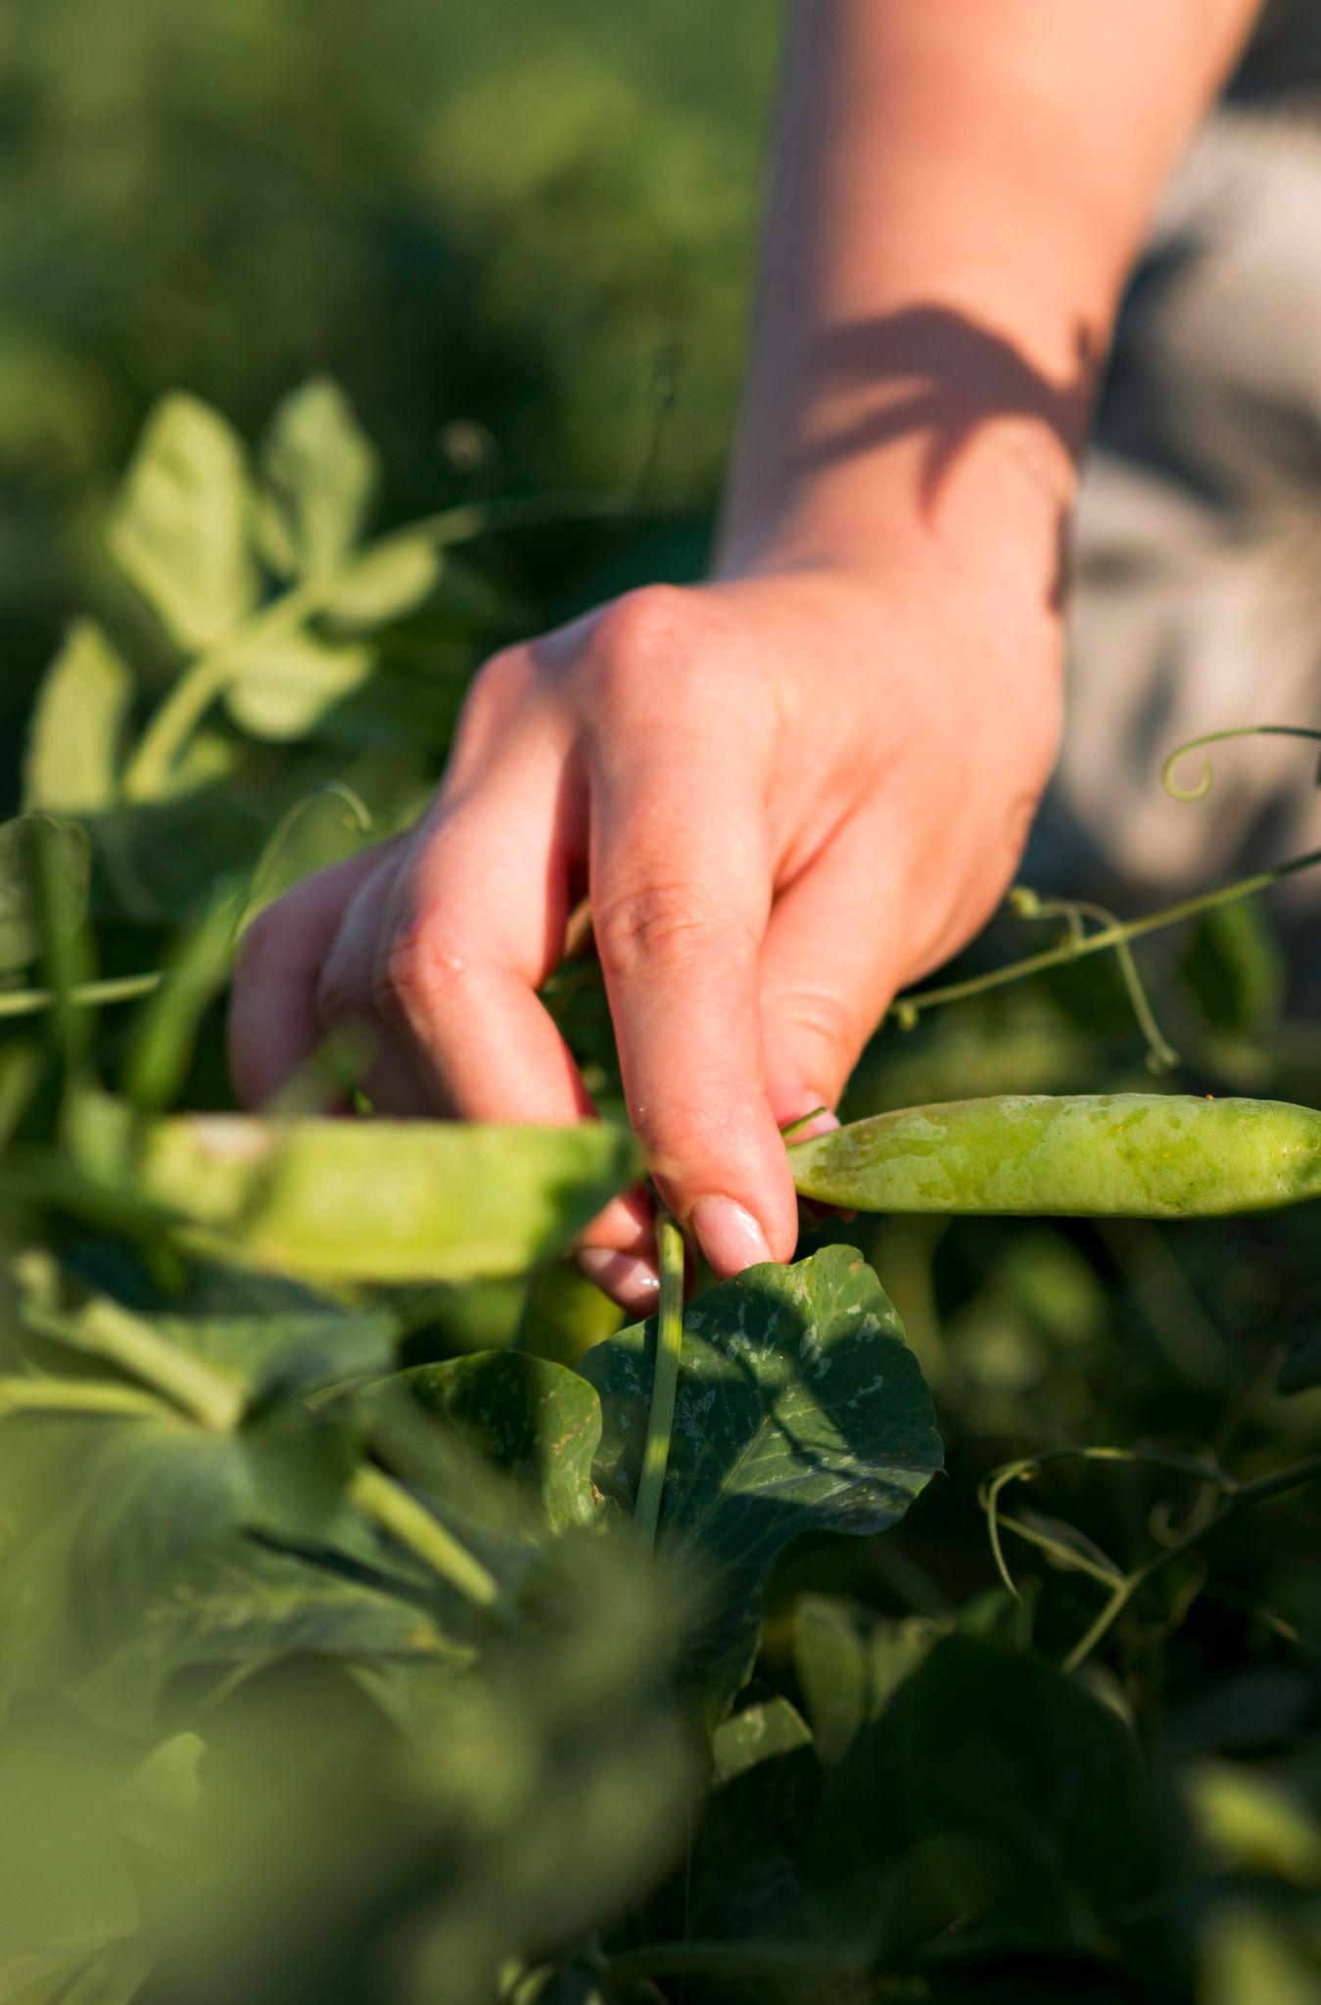
Introduction
Problem Definition
Suggested Solution
Related work
Recent Technologies​

Slide 5
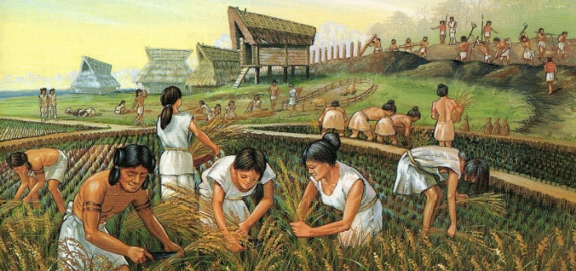
Problem Definition
Agricultural technology is advancing at a rapid pace, providing new and innovative solutions to some of the world's most pressing agricultural challenges. From agroecology to precision farming and machinery, this presentation will explore the latest trends and practices in the field

Slide 6
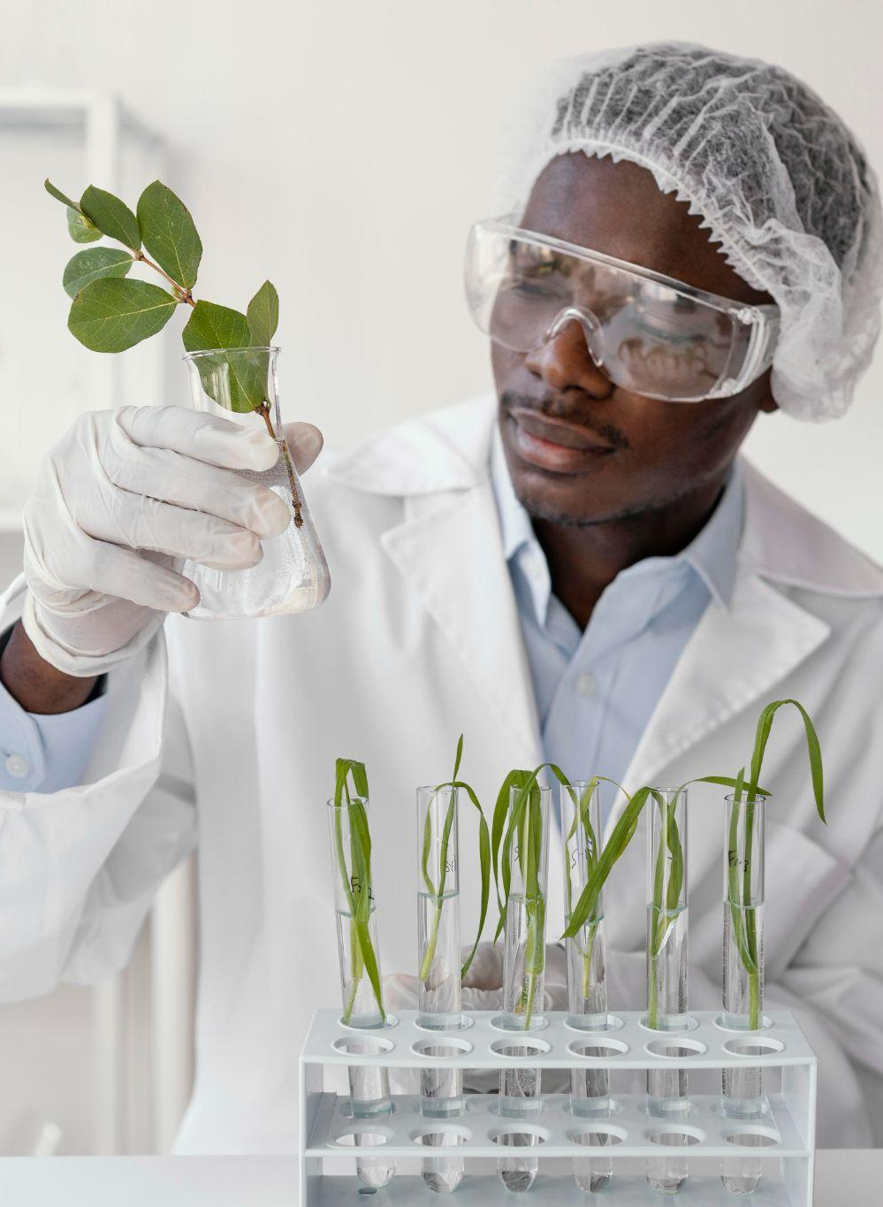
Suggested Solution
The main goal of the proposed system project is to address this issue, and it does so by combining Internet of Things (IoT), Machine Learning (ML) technologies and Web Services. The implementation strategy is based on the use of a low-cost camera and sensor system to identify the type of plant, determine whether it is sick, as well as its solid status and make decisions in accordance with that status. Displaying this information on a website with some features to help the user in managing his fields remotely and easily.

Slide 7
Related Work
Paper 1 [1] 2022
Paper 2 [2] 2022
 | SVM | Naive Bayes | RF
Bacterialc blight | 98.34% | 75.99% | 85.01%
Alternaria | 92.45% | 77.34% | 86.21 %
Grey mildew | 91.56% | 72.45% | 79.99%
Cerespora | 97.45% | 69.34% | 82.45%
 | Uttar Pradesh | Karnataka
Naive Bayes | 40.59% | 63.635%
Logistic Regression | 78.481% | 69.354%
Decision Table | 80.739% | 72.327%
Random Forest | 84.174% | 75.598%

Slide 8
Recent Technologies​
Taranis
Agremo
Utilizes high-resolution imagery and ML algorithms to detect and manage crop diseases, pests, and nutrient deficiencies.
Uses aerial imagery and ML algorithms to analyze soil data, providing information on soil moisture, nutrient levels, and other soil parameters.

Slide 9
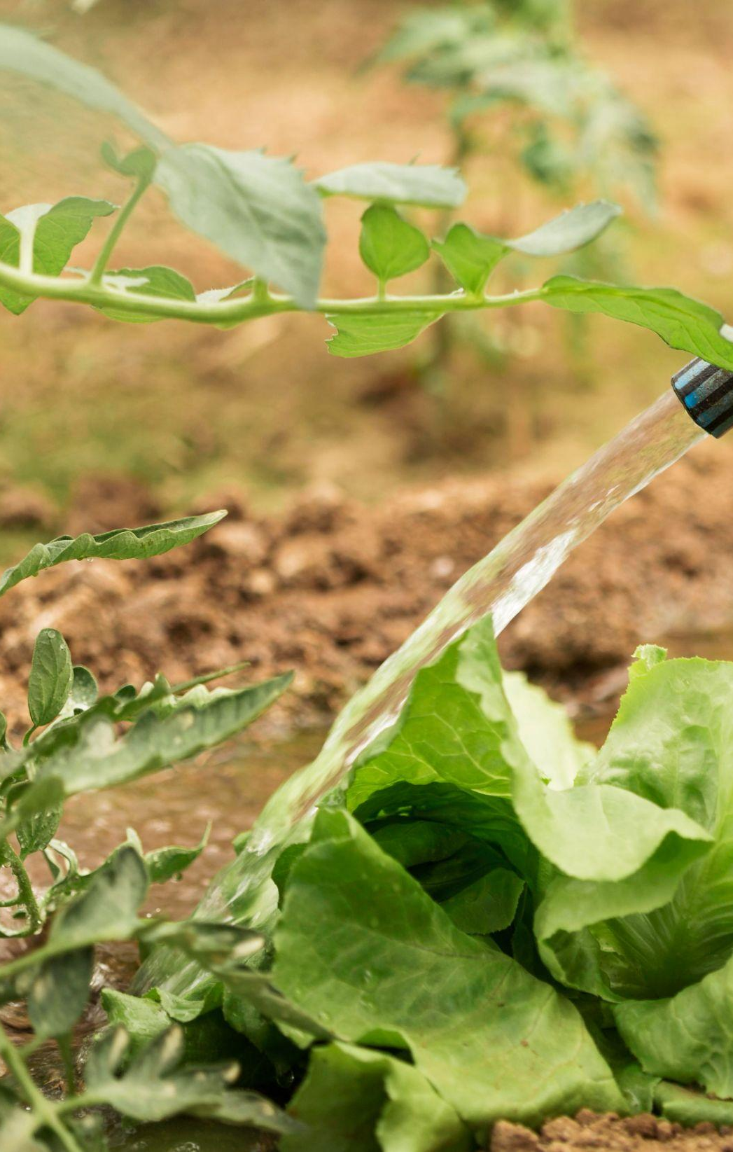
02
Deep Learning
Datasets
Models
Challenges

Slide 10
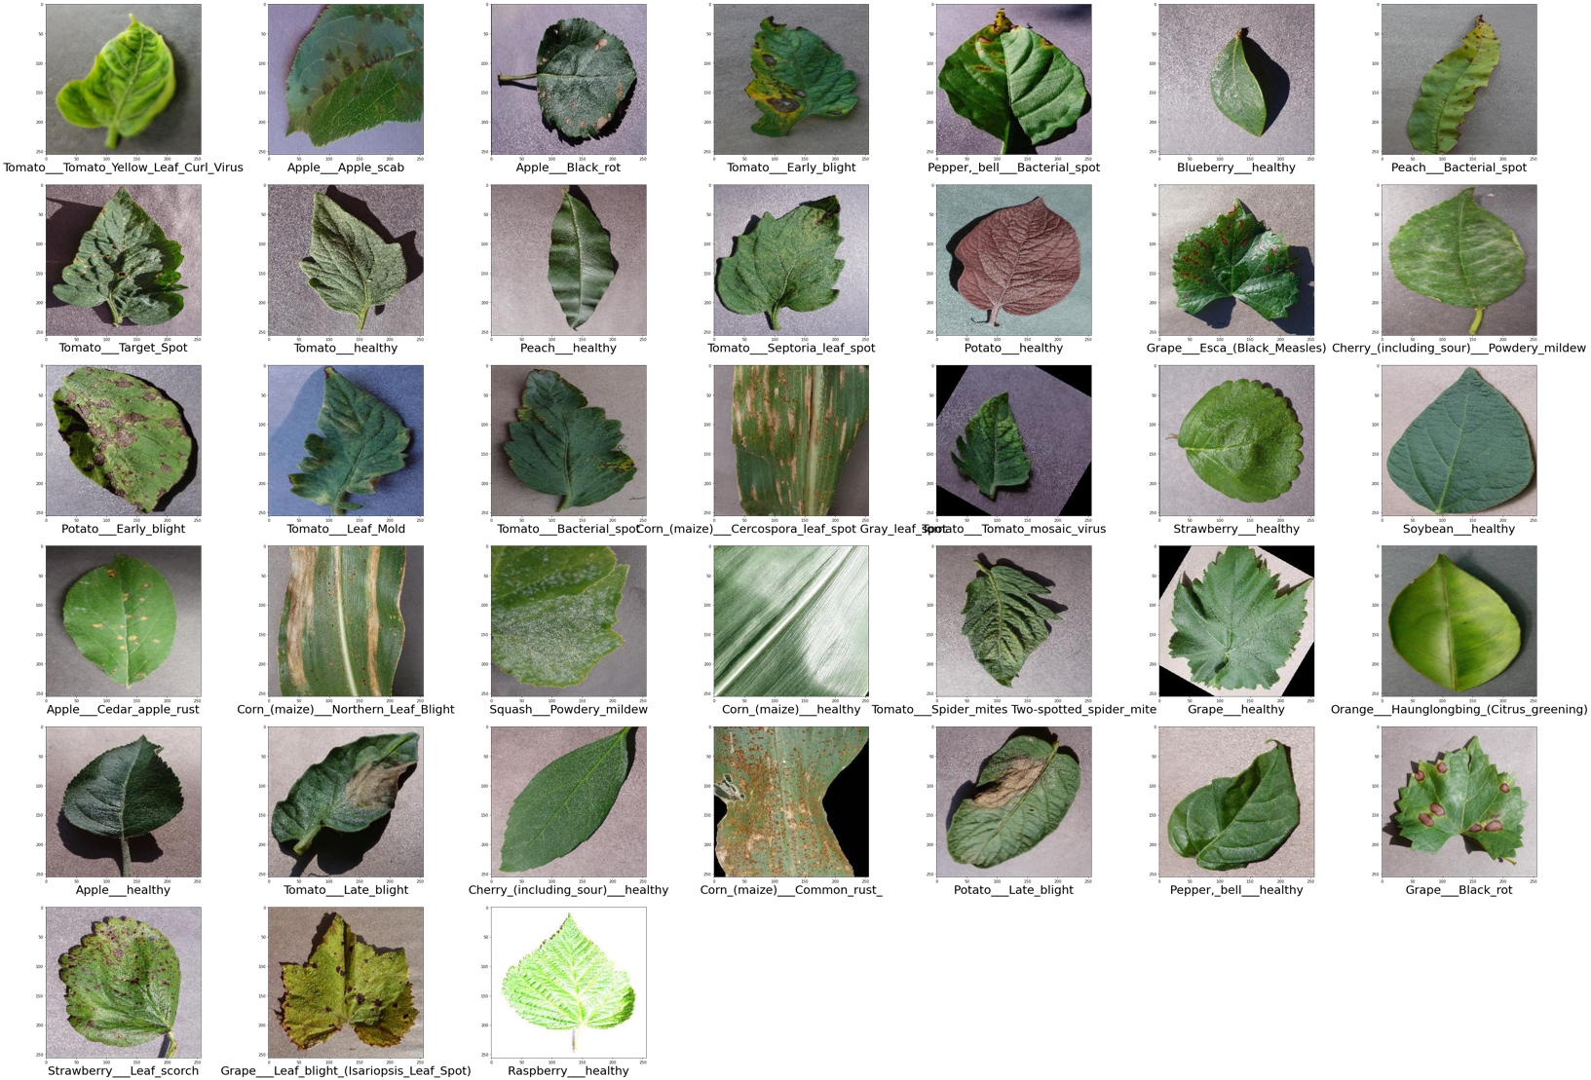
Datasets
New Plant Diseases
87K RGB Images
80/20 (Train/ Valid)
38 Classes

Slide 11
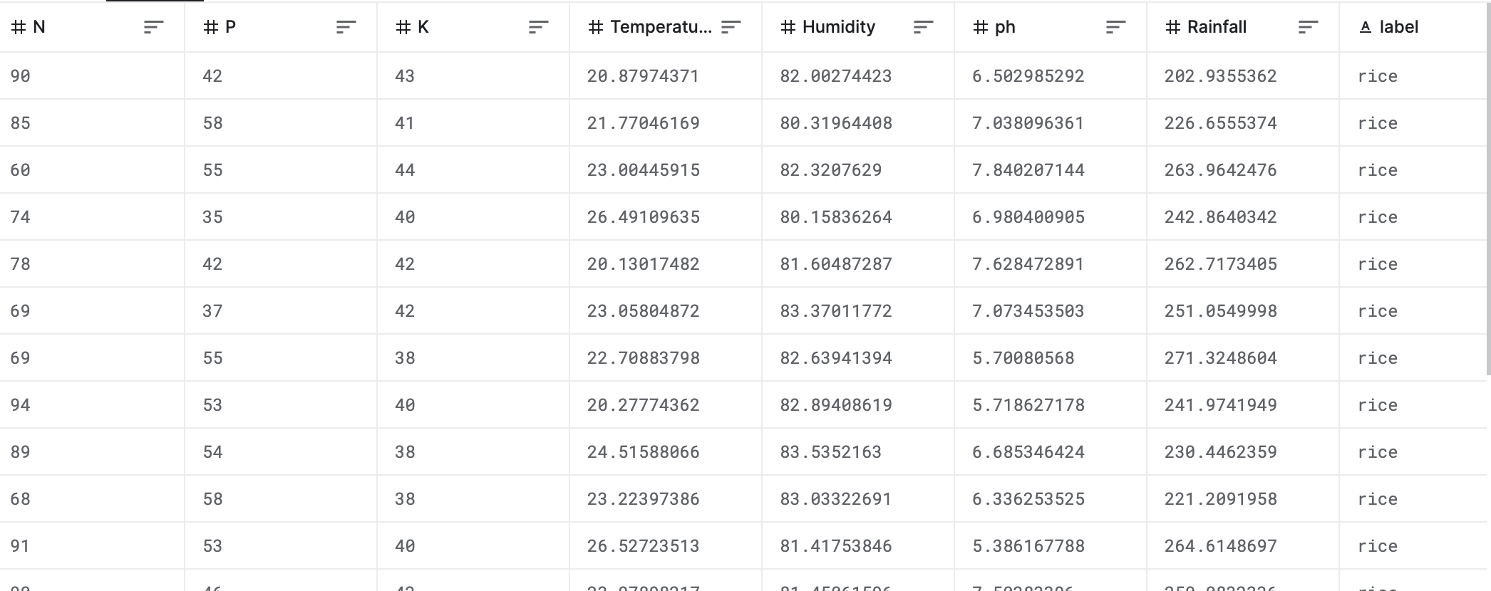
Datasets
Crop Recommendation Dataset
2200 Records
80/20 (Train/ Valid)
22 Classes

Slide 12
Crop Diseases Classification
CNN
Label Binarizer
(256, 256) Image size
Relu Activate Function
Softmax Activation Function
LR = 0.0001
Adam Optimizer
Sparse Categrical Crossentropy
Text to Int + one-hot vectors
Quantization
Model size 107 MB
Post-training quantization

Slide 13
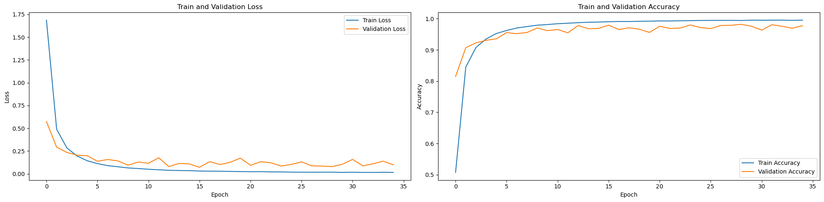
Crop Diseases Classification
Results
Train Accuracy | 99.15%
Test Accuracy | 97.75%
Precision Score | 97.75%
Recall Score | 97.75%
Long Training Time
35 epochs

Slide 14
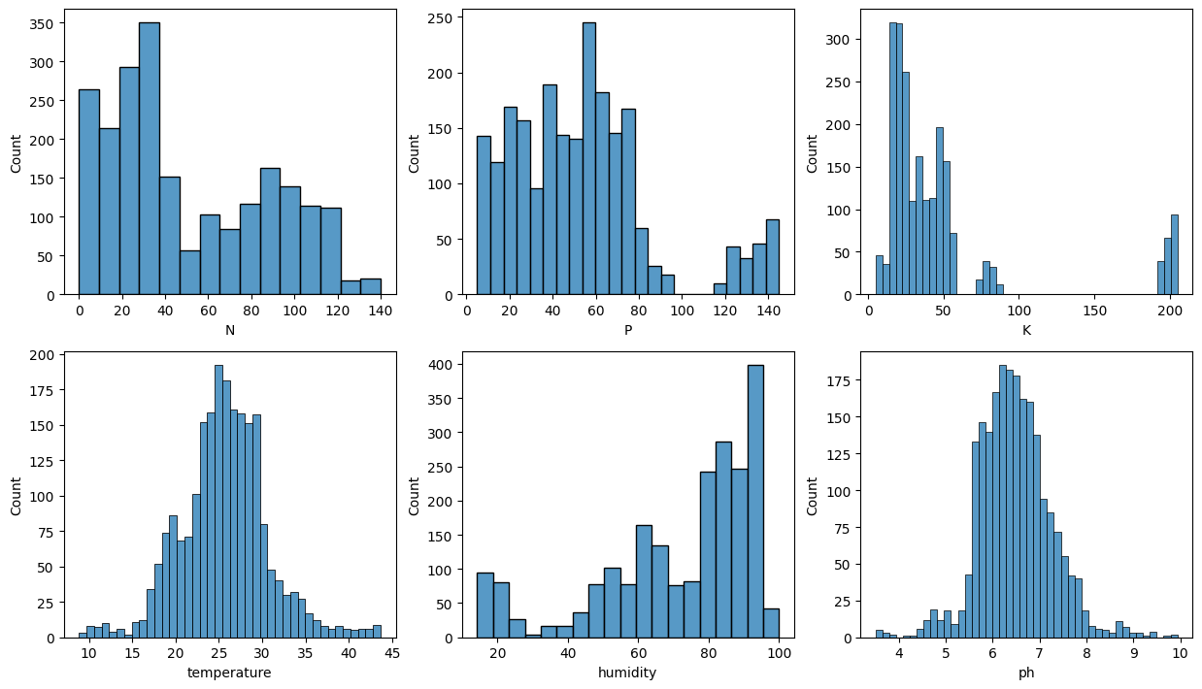
Crop Diseases Classification
Pre-Processing & Model
Exploratory Data Analysis
Decision Tree
Naive Bayes
SVM
Logistic Regression
Random Forest

Slide 15
Crop System Recommendation
Results

Slide 16
Conclusion
Pre-Processing
Dataset Collection and Injection
Image Data Generation (Problems and Suggestions)

Slide 17

03
Mobile Development
Android Application Deployment

Slide 18
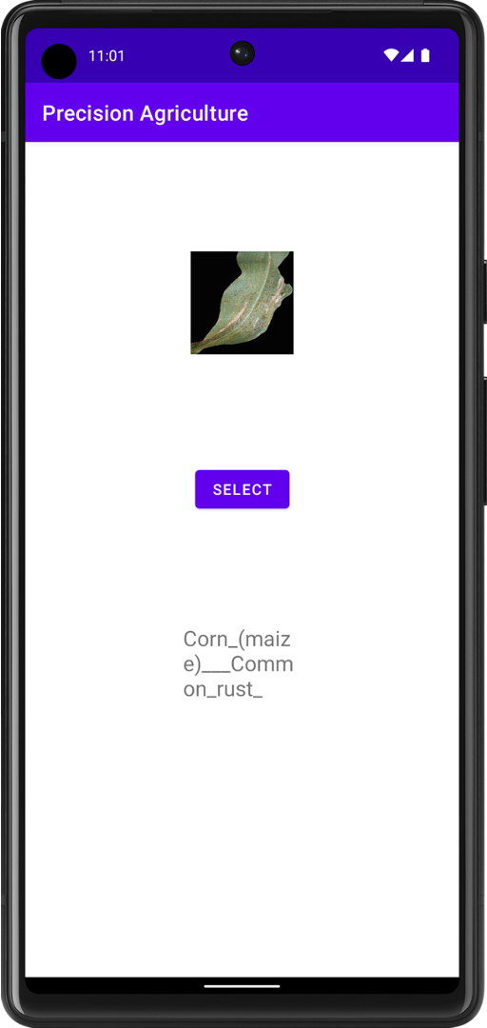
Android Application
Java 17.0.6 – Gradle 7.5
Gray Scale
Process Cycle

Slide 19
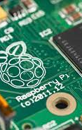
04
Embedded System
Devices and sensors

Slide 20
About this embedded system
The embedded system for your land is divided into four main parts: the lighting part, irrigation part, fertilizing part ,and camera part. the different parts of the embedded system work together to create a comprehensive and automated solution for smart farming. By integrating different sensors and controllers, the system provides real-time monitoring and control of the environmental factors that affect plant growth and health. This can help farmers optimize their practices, reduce waste, and increase yields.

Slide 21
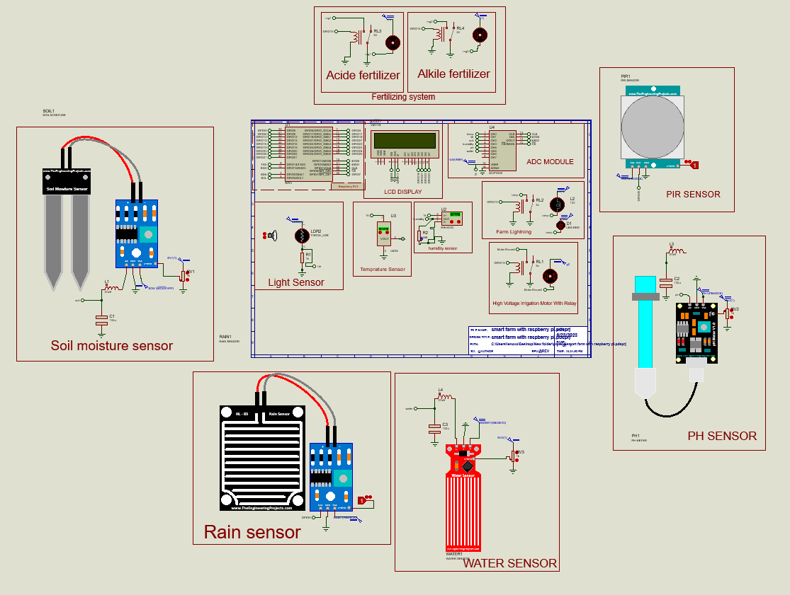
Simulation of the embedded system

Slide 22
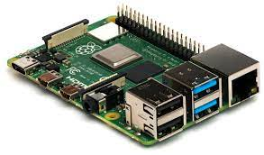
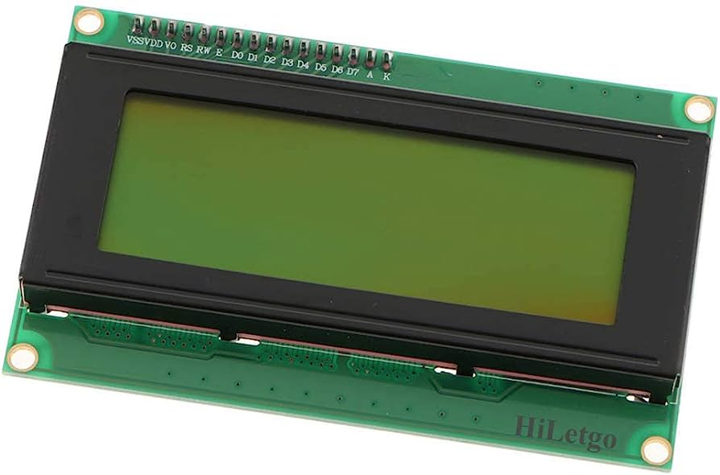
Basic components
Raspberry pi
Display screen

Slide 23
Parts of embedded system
Lightning
Irrigation
Fertilizing
Camera
This is responsible about the lights in our lands
Water pump that provide the land with water
This part is responsible increase the quality of our crops
This part is used to take some photos about the plants

Slide 24
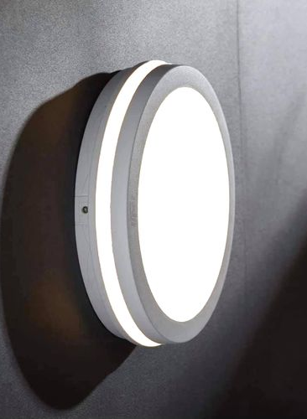
Lightning
What it is doing ?
This part is responsible for the lightning of our lands at the night and while the light of the sun is low

Slide 25
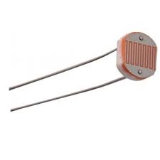
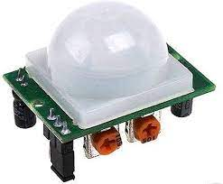
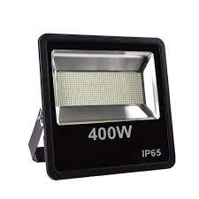
Components
Light sensor
Pir sensor
Lights
Sensor used to detect the light value in the land
This sensor detect the movement on the lands
All lamps that we have in the land

Slide 26
How it works ?
Detect motion
Lights on
Person & low light
Pir sensor
Break point
No person
Lights off
Check the results by raspberry pi
Person & high light
Light sensor
Detect light value
Lights off

Slide 27
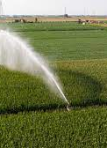
Irrigation
What it is doing ?
This part is responsible for the irrigation of the lands according to some values that it will get from its components

Slide 28
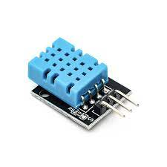
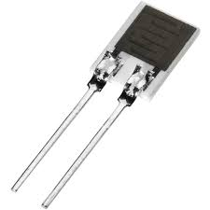
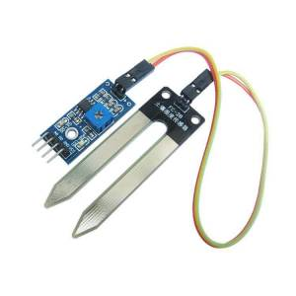
Components
Temperature sensor
Humidity sensor
Soil moisture sensor
Sensor used to detect the temprature value of the air
This sensor detect the humidity value for
This sensor used to detect the value of the moisture of the soil

Slide 29
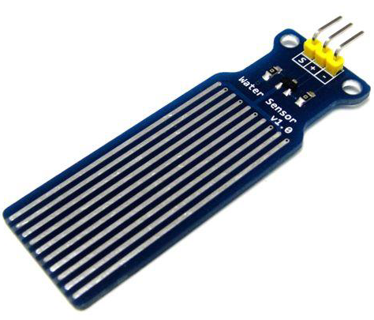
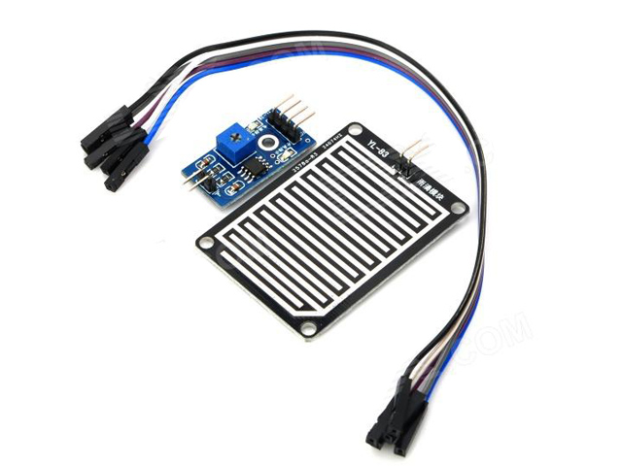
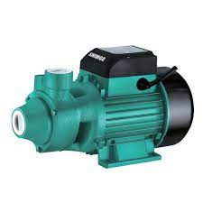
Components (cont..)
Water level sensor
Rain sensor
Water pump
This sensor detect the value of the water level in the land
This sensor checked if there is a rain or not
Water pump provide the land with water according to some values

Slide 30
How this part work ?
First temperature sensor check the value of the temperature, if the value is high then another sensor is check its value here which is soil moisture sensor, this sensor check the value of the moisture of land’s soil, if this value is low ,then the system turn on the water pump.
So after the system turned on the motor, system must check the value of water level in our farm , so we used water level sensor to check this value, if this value is high then the system turn off the motor.
Also our system uses rain drop sensor to check if there is rain in our farm, if there is rain then our system turn off the motor, so we can save some power and save the usage of water.
Finally when rain is stopped our system check the values of our sensors then decide if system need to turn on the motor again or not.

Slide 31
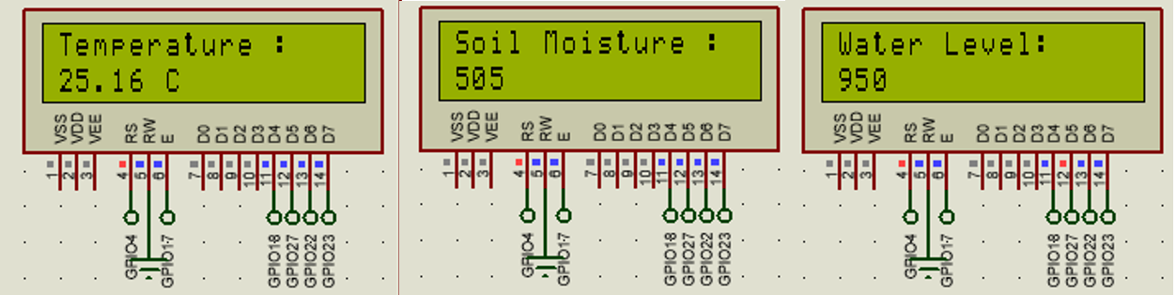
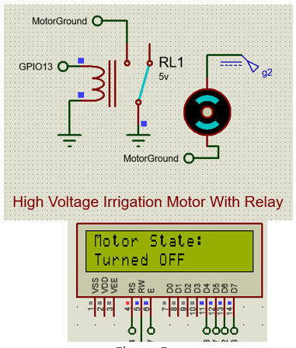
Tests and results
Test 1
Result

Slide 32
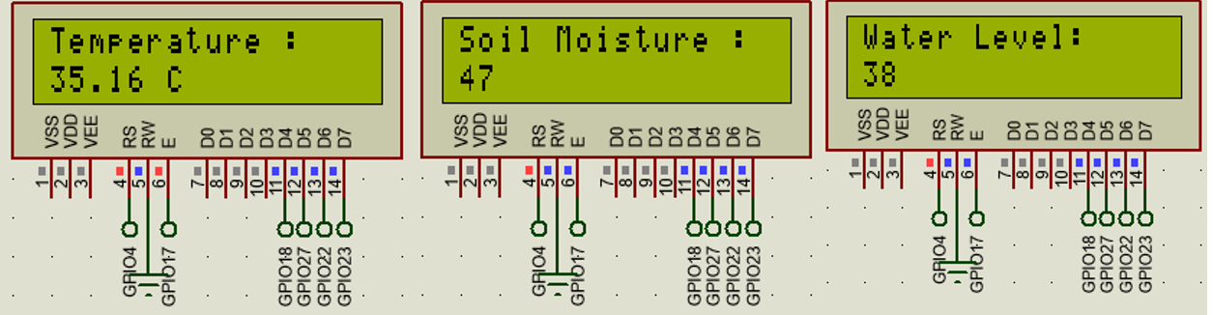
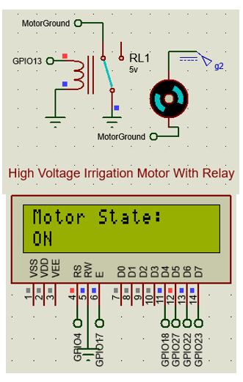
Tests and results (cont.…)
Test 2
Result

Slide 33
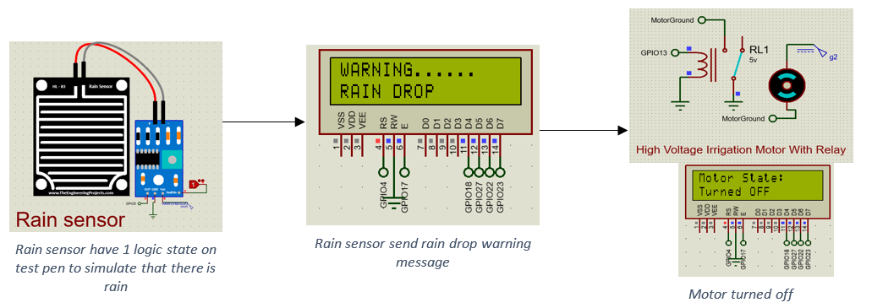
Tests and results (cont.…)
Test 3
Result

Slide 34
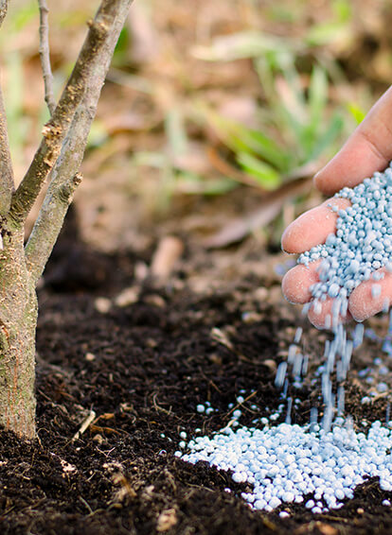
Fertilizing
What it is doing ?
This part is responsible for fertilizing the land to increase the quality of the yields and make the soil is good for these yields.

Slide 35
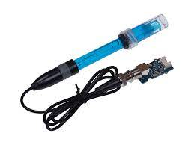
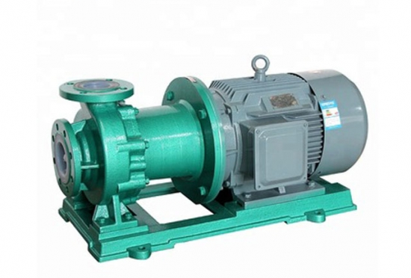
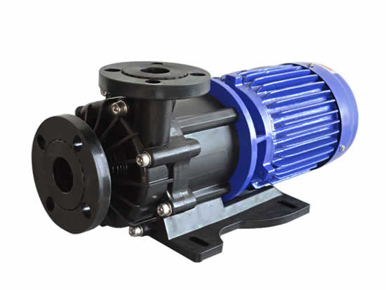
Components
PH sensor
Acid pump
Alkyl pump
This sensor give us the value of PH of the soil
This pump turned on when PH value of the soil is greater than perfect PH value for crop
This pump turned on when PH value of the soil is lower than perfect PH value for crop

Slide 36
How this part works ?
Every crop that you want to plant in your land have perfect value of PH for the soil which it will be planted in it .
Some examples about that :
Apple ---→ 3.5
Rice --→ 6-6.7
tomato -→ 4.3 -4.9
potato -→5.4-5.9
So according to these we have 2 pumps in our land one is for alkyl fertilizing material , another for acid fertilizing material .
The purpose of these pump is make the PH value of the soil is very near to the perfect PH value for the crops .

Slide 37
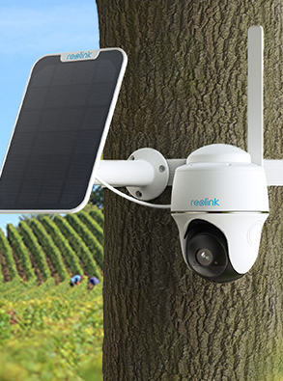
camera
About this part?
In this part we use a camera that is connected wirily with the main components which is raspberry pi , this camera talk some images for our crops in the lands , then sends these photos to AI model to deal with them and do its purpose

Slide 38
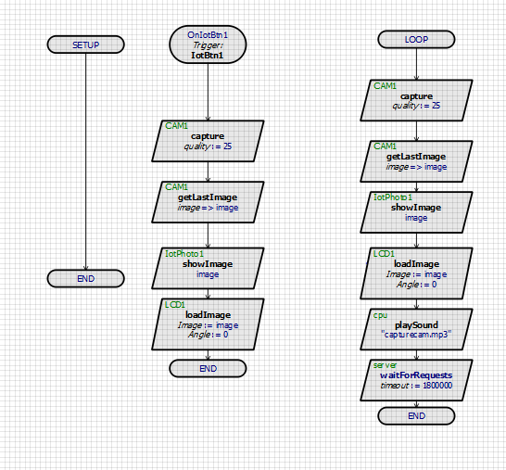
Working algorithm of camera
According to our algorithm , this camera take images every 30 minutes (this time is random only for testing), also this camera is also should be connected to a mobile application with the whole system , so you can take and see some images about your land every time you want that

Slide 39
How system get and send data ?
Embedded system
API
Server

Slide 40
Conclusion
As you see this system is a good system to begin with precision agriculture , but also it may have some improvements in the future may on part of the system like fertilizer that it may be add some features to it to make it more efficient , also we can made some improvements on camera to be may on drone ,
We have more and more improvements that we can do it to this system but it cost more effort , more time and more money .

Slide 41

05
Front-end Development

Slide 42
About front-end of the website
The front end of a precision agriculture website is the user interface that displays data and provides interactive tools for farmers to manage their agricultural operations. It includes features such as mapping tools, data visualization components, and crop management tools that allow farmers to make informed decisions about their operations. The front end can help farmers optimize their farming practices and increase yields by providing a user-friendly interface and powerful data visualization tools.

Slide 43





Technologies used

Slide 44
Website components
01
02
03
04
Landing page
Authentication
05
Readings
Maps
AI model

Slide 45
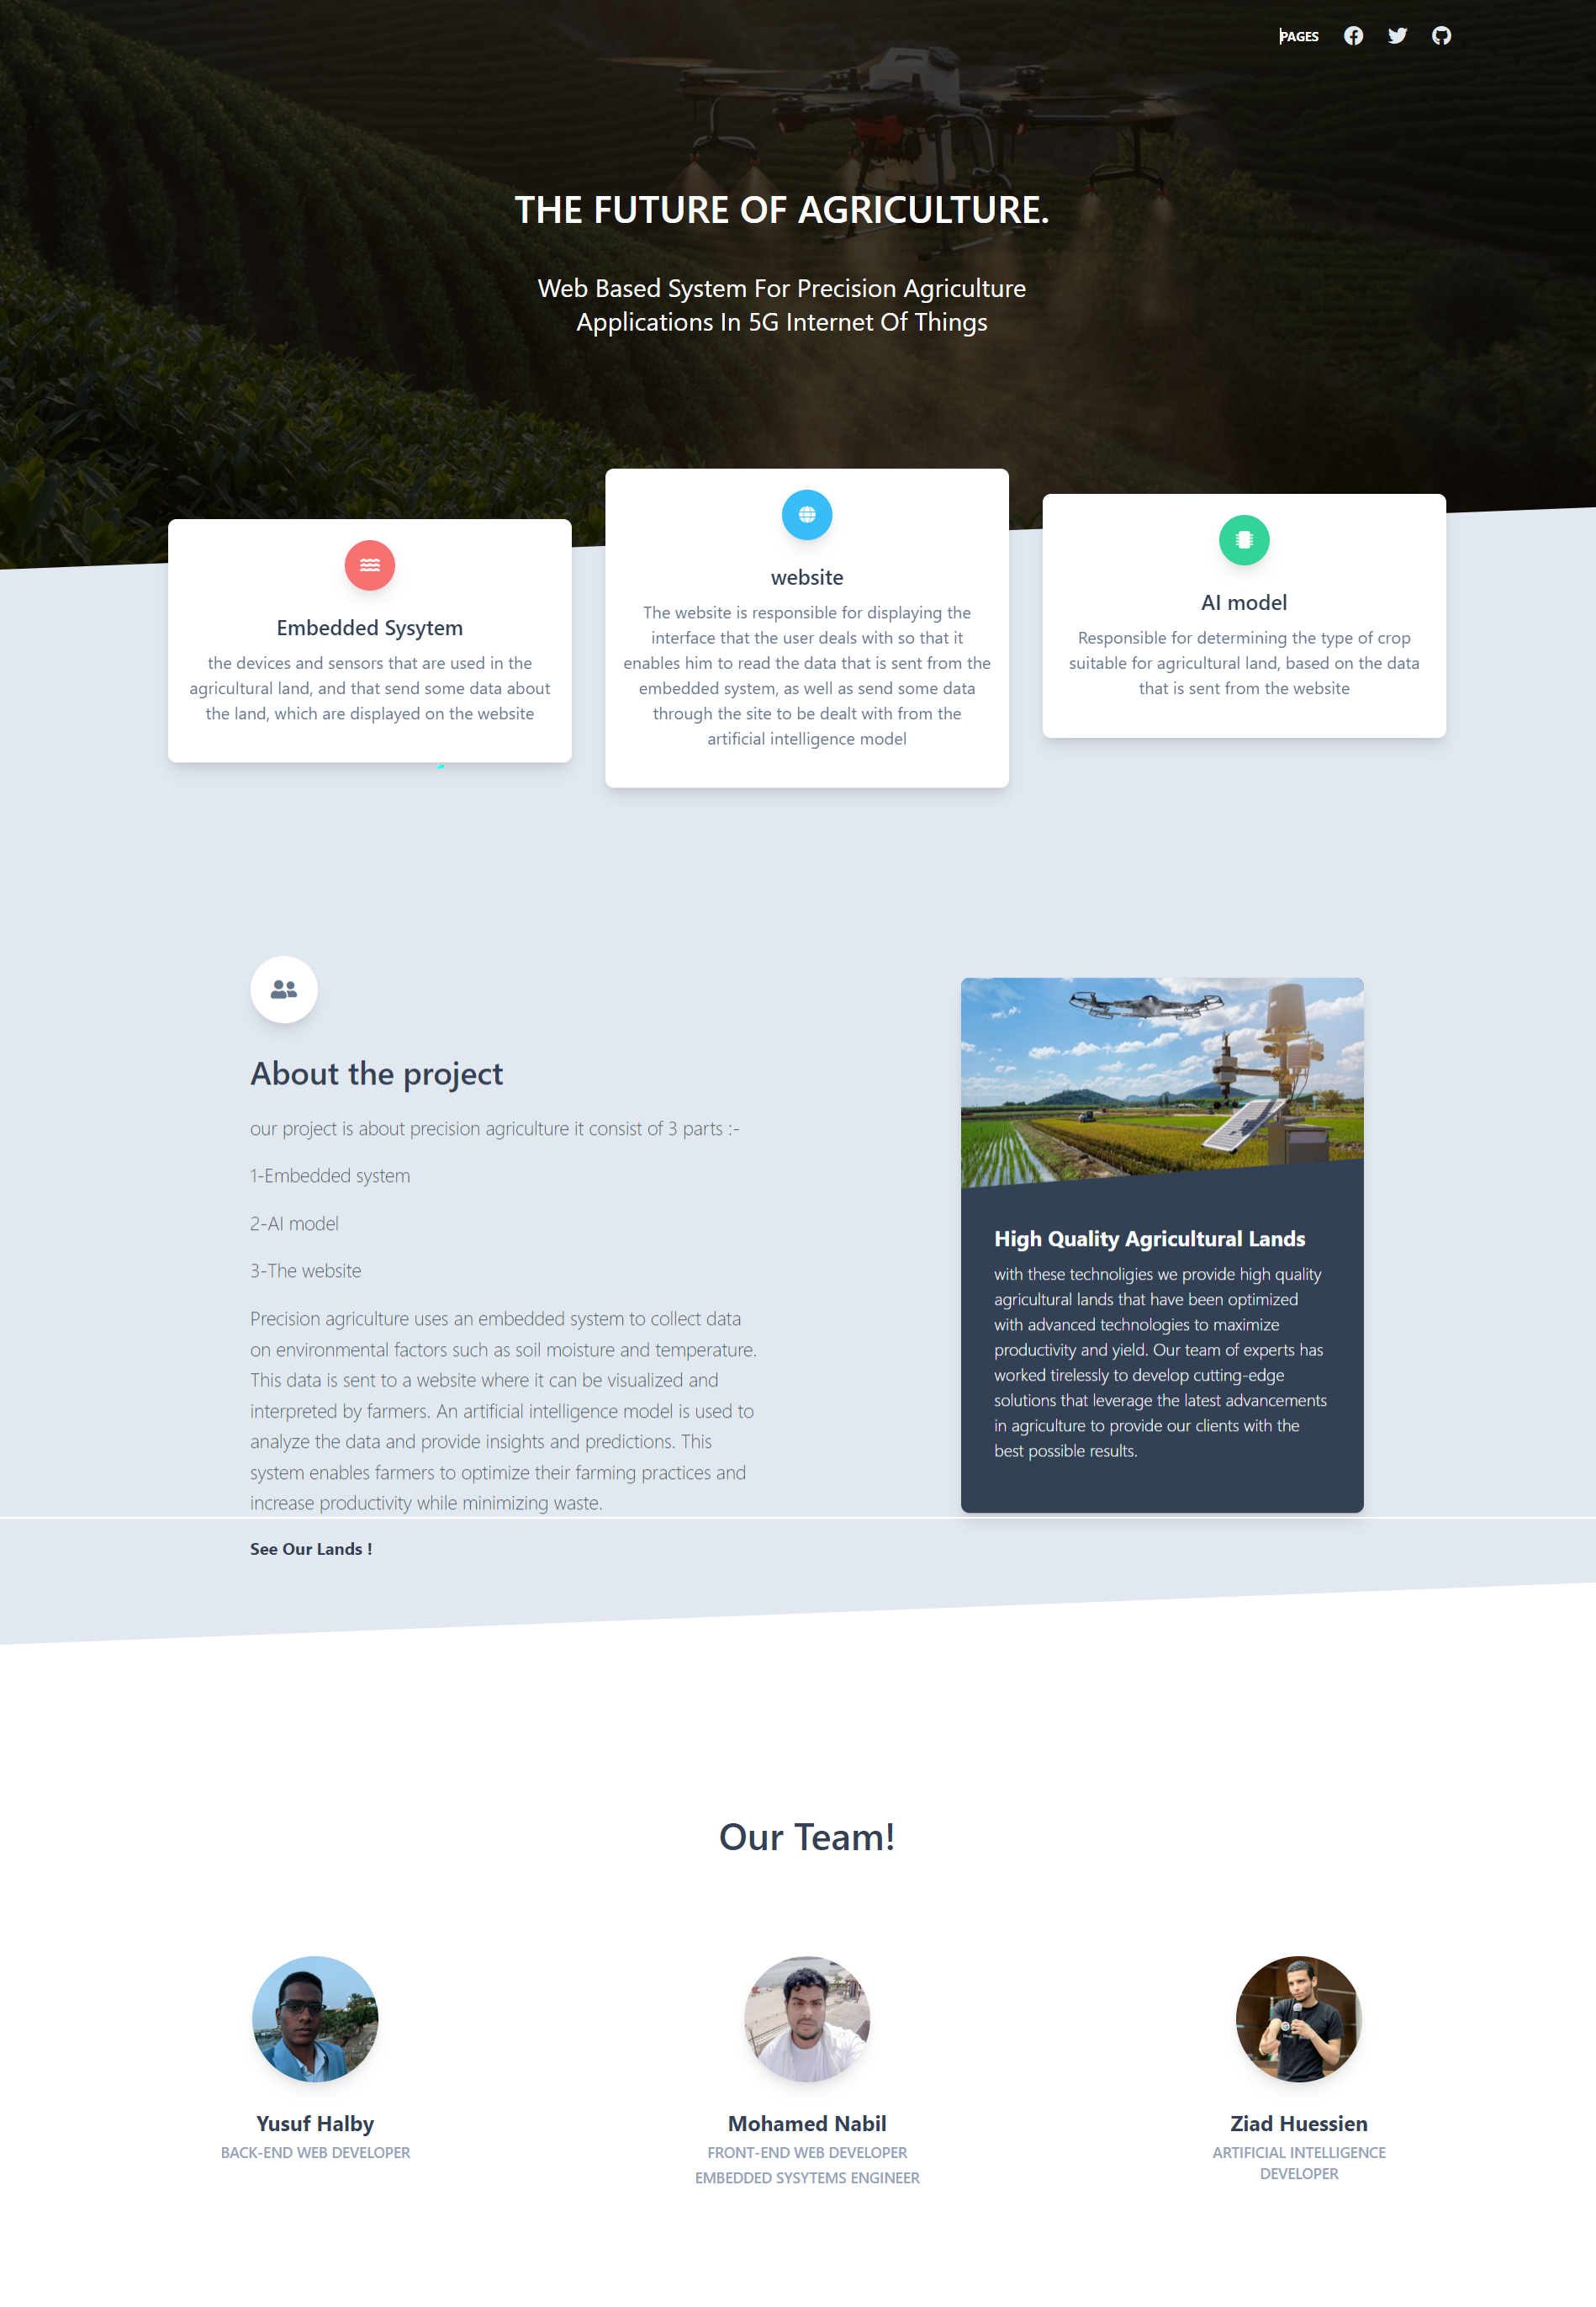
Landing page
Landing page is consists of 3 sections , one talk about every part in this graduation project ,another talk about the whole project and the last section is our team

Slide 46
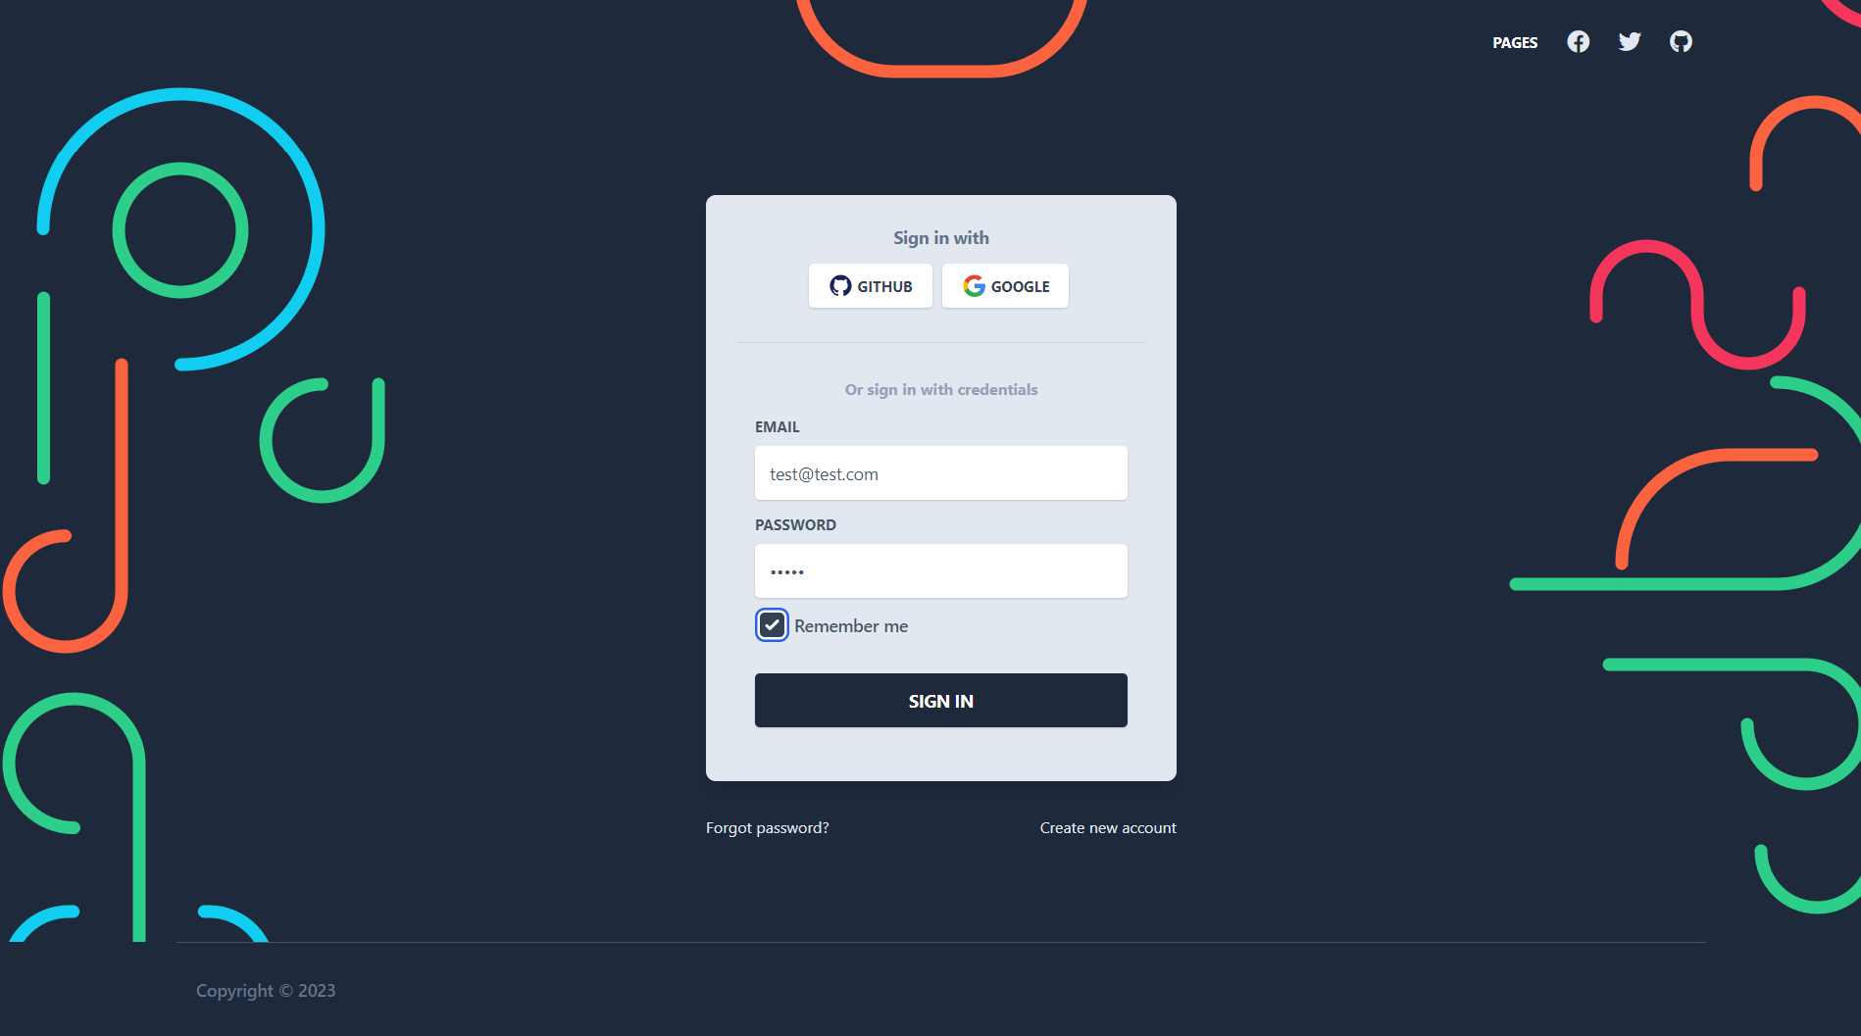
Authentication
This page is took you to register or login in the website to know if you are admin or normal user ,any time you want to go to admin pages the website will prevent you until you login as an admin

Slide 47
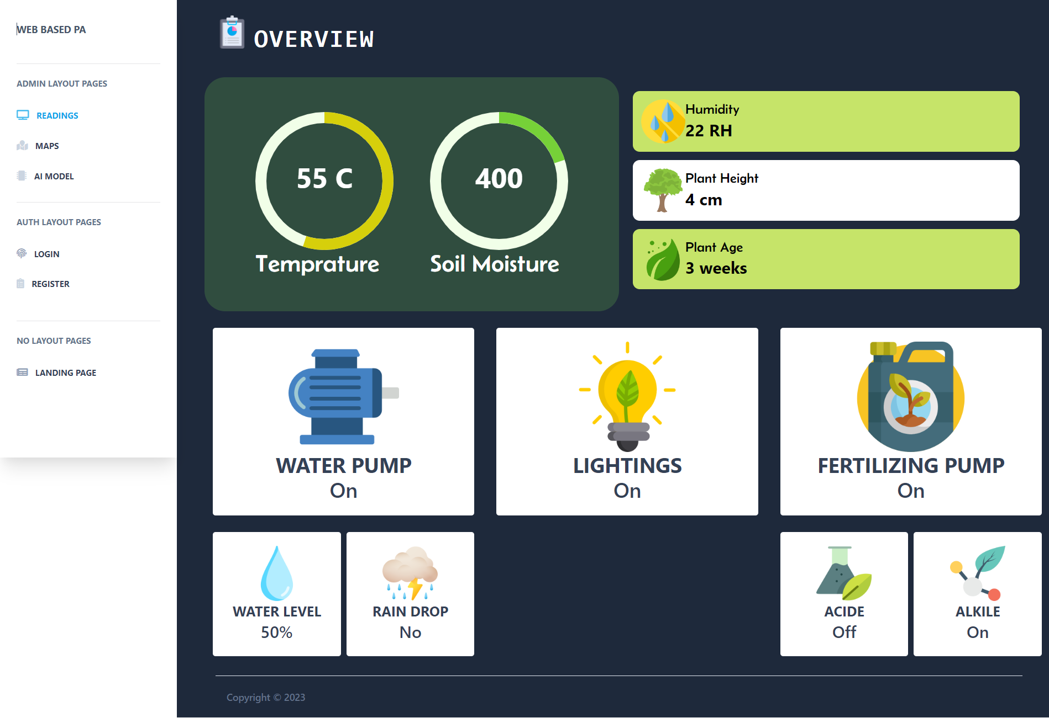
Reading page
This page is consist of all readings that the embedded system send to the server ,which are displayed in good ui , this page get all from an api that is made by backend developer, also this page is related with next page which is maps page

Slide 48
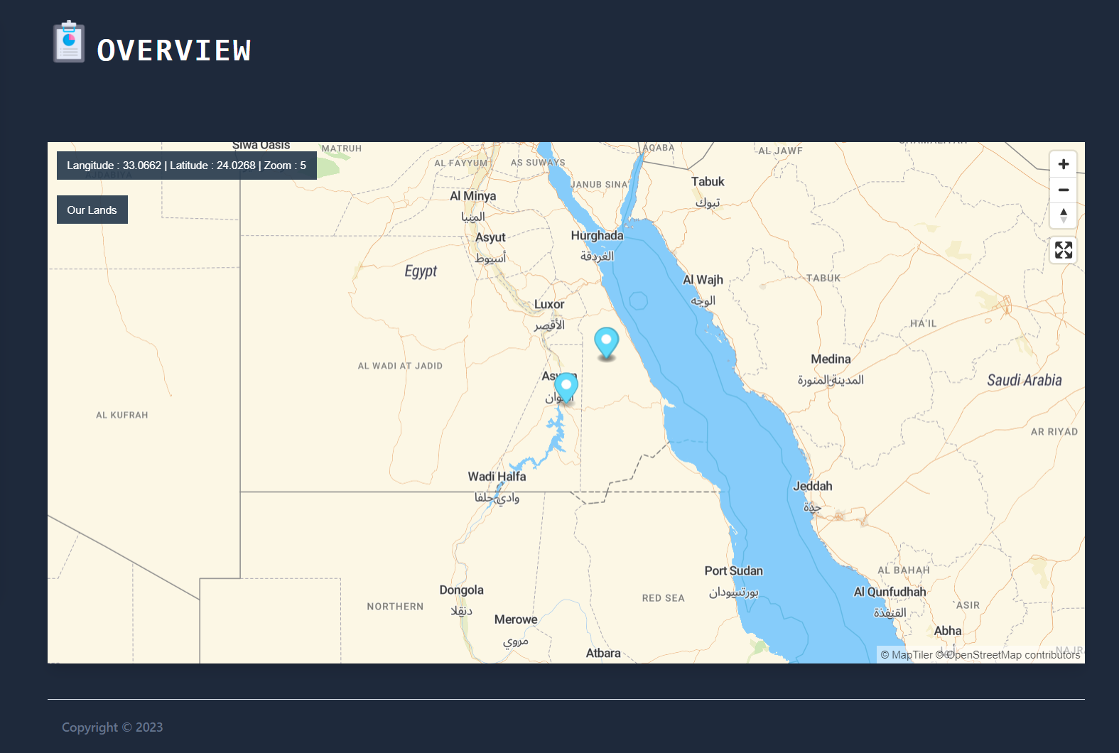
maps page
This page is show a map that is show all locations of our lands in this system ,also when you click on any marker you see some details about the land ,then if you click more details button you will go to the readings page which display all readings about this land maps is displayed by an api that is maplibre-gl

Slide 49
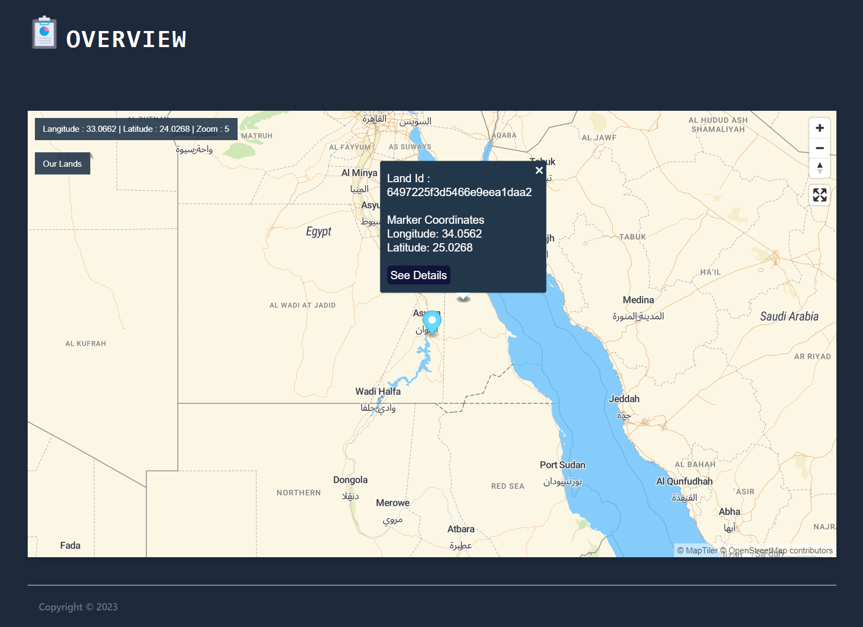
maps page
See this , when you click see details on the map you will go to the reading page to see all details about the land

Slide 50
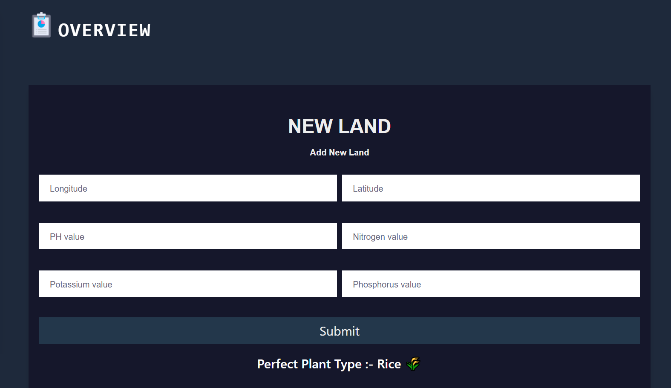
AI model page
This page display a form that it will take some details about your new land that you want add it to your system then it tell you about the perfect crop that you should plant in your land ,

Slide 51
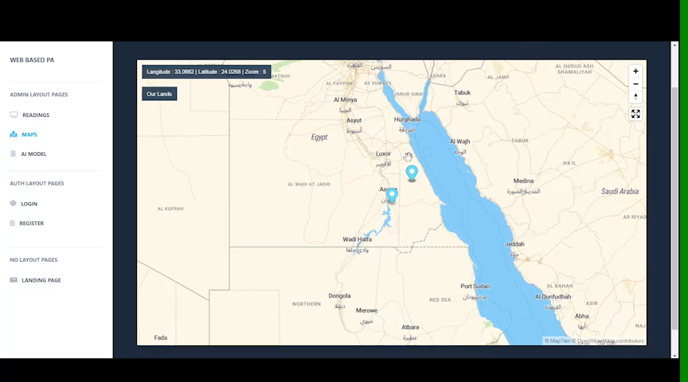
Live demo

Slide 52
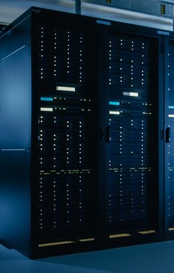
06
Backend RESTful API

Slide 53
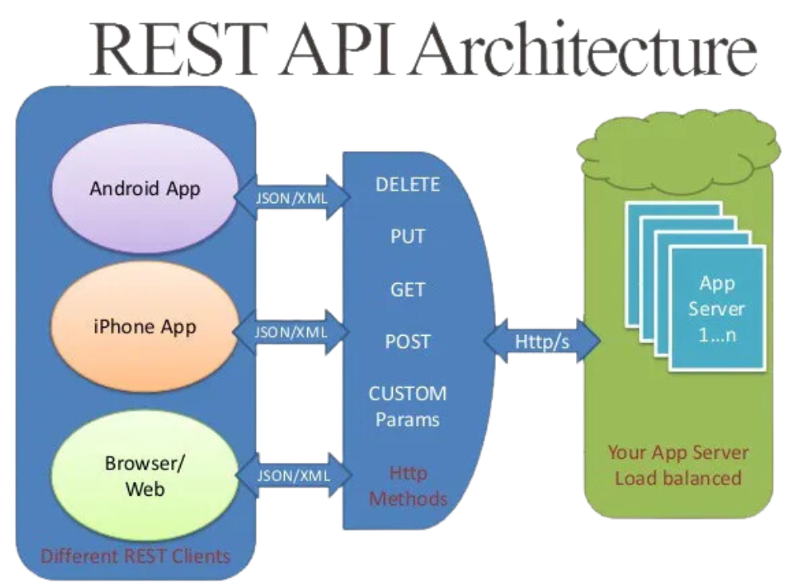
RESTful APIs
RESTful APIs are a design approach for building web services that follows the principles of REST (Representational State Transfer).
They use standard HTTP methods (GET, POST, PUT, DELETE) for performing CRUD operations on resources identified by unique URIs.
RESTful APIs are stateless, meaning each request is independent and self-contained.
They support various data formats, often using JSON for data exchange.
The APIs are simple, scalable, and promote a uniform interface, making them easy to understand and consume.

Slide 54
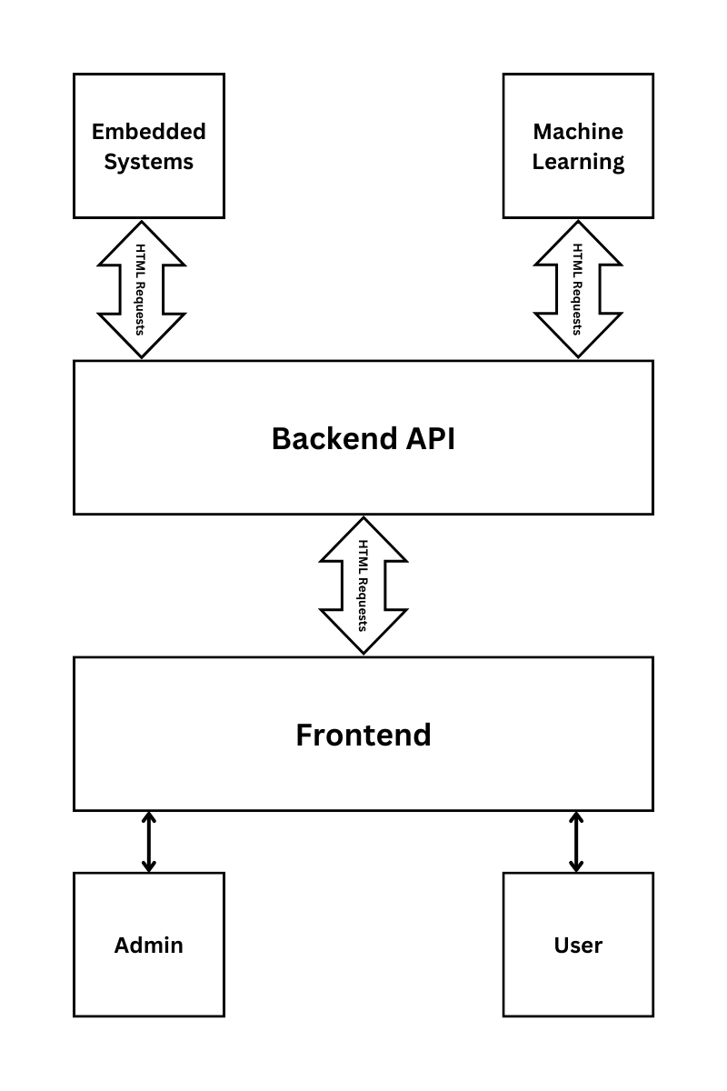
Integration and Control Hub
The API serves as the central integration and control hub in our precision agriculture project. It connects and orchestrates the seamless communication between various components, enabling the optimization of agricultural outputs through IoT technologies and 5G networks.

Slide 55



Technologies
Node.js
Server-side JavaScript runtime. Allows running JavaScript on the server. Event-driven, non-blocking I/O model. Rich ecosystem with npm.
Express.js
Minimalist web application framework. Built on top of Node.js. Simplifies routing and handling HTTP requests. Flexible and efficient for building web applications and APIs.
MongoDB
NoSQL database. Document-oriented with dynamic schemas. High performance and scalability. Supports various data models. Efficient query language and indexing capabilities.

Slide 56
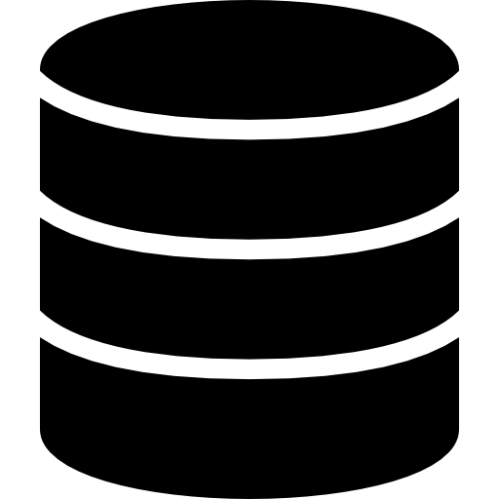


API Architecture
MVC
Architecture
Model
View
Responsible for managing data.
Responsible for data presentation.
Controller
Controlling the flow of data and processing user actions.

Slide 57

Data Modeling
Mongoose is an Object-Data Modeling (ODM) library for Node.js, specifically designed for MongoDB. It provides a higher-level abstraction layer over MongoDB, making it easier to work with the database. Mongoose allows developers to define schemas, models, and relationships for their data, providing validation, querying, and middleware capabilities.

Slide 58
Database Collections
User
Has name, email, password, can be a super admin
Land
Device
Has plant label, optional description, coordinates
Has pumps indicators, responsible of logs and photos
Logs
Photos
Has measurements from sensors, AI analysis result
Has link to photo on server, AI analysis result

Slide 59


Authentication
JSON Web Token
Bcrypt
A secure, compact, and stateless method of transmitting information between parties as a JSON object
A popular hashing function used for password hashing and encryption

Slide 60

Data Validation
Express-validator is a middleware library for Express.js that provides an easy way to validate and sanitize user input data. It simplifies the process of validating form inputs, query parameters, or request bodies, ensuring that the data meets specific criteria or constraints. Express-validator helps prevent common security vulnerabilities such as cross-site scripting (XSS) attacks or SQL injection by sanitizing and validating user inputs.

Slide 61
Flow
Register with name, email, and password
Add an ID, plant, and coordinates
Put the ID of the device in the embedded system to function
Signup
Add Land
Setup Device
Login
Add Device
Sign in by email and password and get a token
Associate a device to your land

Slide 62
The device will provide the measurements and photos
Send Logs & Photos
Change Pumps States
You can toggle the pumps using the API

Slide 63

Security
Helmet.js is a security middleware for Node.js that enhances the security of web applications by setting HTTP headers. It helps protect against common web vulnerabilities like XSS (cross-site scripting) attacks.

Slide 64
Endpoints
Authentication | Super admin getters | Lands
Signup | All Lands | Get User Lands
Login | All Devices | Get Specific Land
 | All Logs | Add Land
 | All Photos | Delete Land
 |  | Update Land

Slide 65
Endpoints
Devices | Logs | Photos
Get User Devices | Get User Logs | Get User Photos
Get Specific Device | Get Specific Log | Get Specific Photo
Add Device | Add Log | Add Photo
Delete Device | Delete Log | Delete Photo
Update Device | Get Logs Of Specific Land | Get Photos Of Specific Land

Slide 66
Middlewares
IsAuth
IsSuperAdmin
Uses the JWT token to specify whether the user has valid credentials or not
Uses database to check if the logged in user has super admin privileges

Slide 67


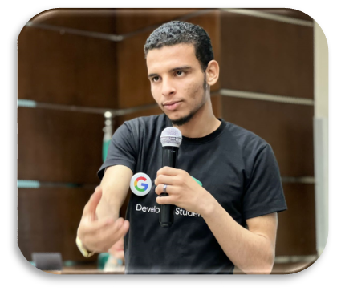
Our Team
Yusuf Halby
Mohammed nabil
Ziad Hussien
Backend Web Developer
Frontend & Embedded Systems Developer
Deep Learning Developer

Slide 68
Thanks!

